Slide 1


Professional practices
Personal Development Plan
Dr. Salima Ahsan Tejani

Slide 2
Welcome!!
Week 2

Slide 3
Agenda
01
personal development plan
02
Personal Vision
03
Personal change
04
Skill set required to bring change
05
Preparing Action plan

Slide 4
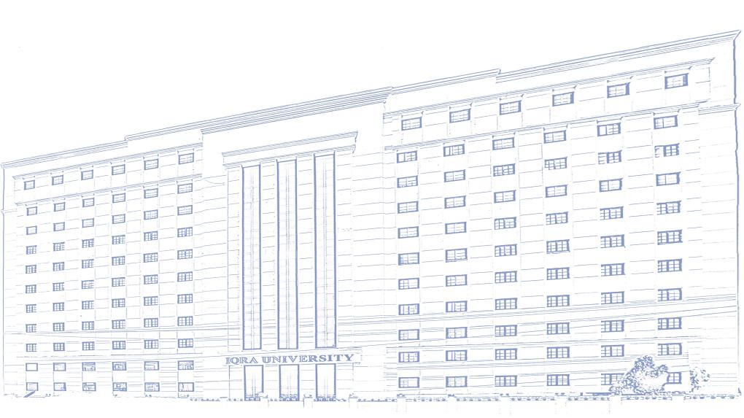
Learning Outcomes
After the completion of this class students would be able to:
Prepare goals for life from there personal vision statement.
Identify the goal they want to achieve in recent present.
Specify the skills set they need to learn in order to achieve goal.
Practice change cycle
Prepare action plan they need to follow to achieve a selected goal.

Slide 5
What is personal vision ?
A clear personal vision is an integration of your abilities, interests, personality, values, goals, skills/experience, family of origin, and stage of adult development.

Slide 6
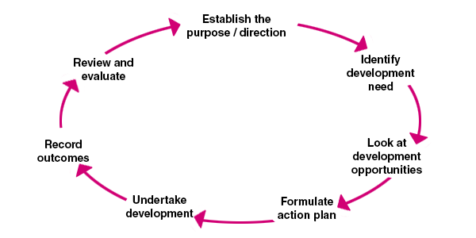
Development Plan cycle

Slide 7
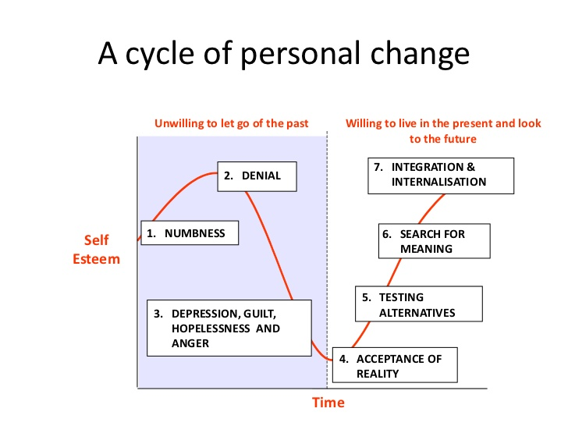

Slide 8
Fill the personal Development plan template
01
02
04

Slide 9
Thank you
End of week

